Slide 1
Percent of Change

Slide 2

$$Percent of Change= \frac{Amount of Change}{Original Amount}$$

Slide 3

Find the percent of change for the following:
$36 →27$ $58 →76$ $600 →480$

Slide 4

Find the percent of change for the following:
$36 →27$

Slide 5

Find the percent of change for the following:
$36 →27$
$$PoC= \frac{36 −27}{36}$$

Slide 6

Find the percent of change for the following:
$36 →27$
$$PoC= \frac{36 −27}{36}$$
$$PoC= \frac{9}{36}$$

Slide 7

Find the percent of change for the following:
$36 →27$
$$PoC= \frac{36 −27}{36}$$
$$PoC= \frac{9}{36}$$
$$PoC=0.25$$

Slide 8
Find the percent of change for the following:
$36 →27$
$$PoC= \frac{36 −27}{36}$$
$$PoC= \frac{9}{36}$$
$$PoC=0.25$$
Remember: You are trying to find the PERCENT of change. This must be converted to a percent.

Slide 9

Find the percent of change for the following:
$36 →27$
$$PoC= \frac{36 −27}{36}$$
$$PoC= \frac{9}{36}$$
$$PoC=0.25$$
$$PoC=0.25 ×100=25\%$$
Remember: You are trying to find the PERCENT of change. This must be converted to a percent.

Slide 10

Find the percent of change for the following:
$$58 →76$$

Slide 11

Find the percent of change for the following:
$$58 →76$$
$$PoC= \frac{76 −58}{58}$$

Slide 12

Find the percent of change for the following:
$$58 →76$$
$$PoC= \frac{76 −58}{58}$$
$$PoC= \frac{18}{58}$$

Slide 13

Find the percent of change for the following:
$$58 →76$$
$$PoC= \frac{76 −58}{58}$$
$$PoC= \frac{18}{58}$$
$$PoC=0.310344828…$$

Slide 14

Find the percent of change for the following:
$$58 →76$$
$$PoC= \frac{76 −58}{58}$$
$$PoC= \frac{18}{58}$$
$$PoC=0.310344828… ≈31\%$$

Slide 15

Find the percent of change for the following:
$$600 →480$$

Slide 16

Find the percent of change for the following:
$$600 →480$$
$$PoC= \frac{600 −480}{600}$$

Slide 17

Find the percent of change for the following:
$$600 →480$$
$$PoC= \frac{600 −480}{600}$$
$$PoC= \frac{120}{600 }$$

Slide 18

Find the percent of change for the following:
$$600 →480$$
$$PoC= \frac{600 −480}{600}$$
$$PoC= \frac{120}{600 }$$
$$PoC=0.2$$

Slide 19

Find the percent of change for the following:
$$600 →480$$
$$PoC= \frac{600 −480}{600}$$
$$PoC= \frac{120}{600 }$$
$$PoC=0.2=20\%$$

Slide 20
Examples
The price on a pair of pants decreased from $32.95 to $28.95. Find the percent of change to the nearest 10th.

Slide 21
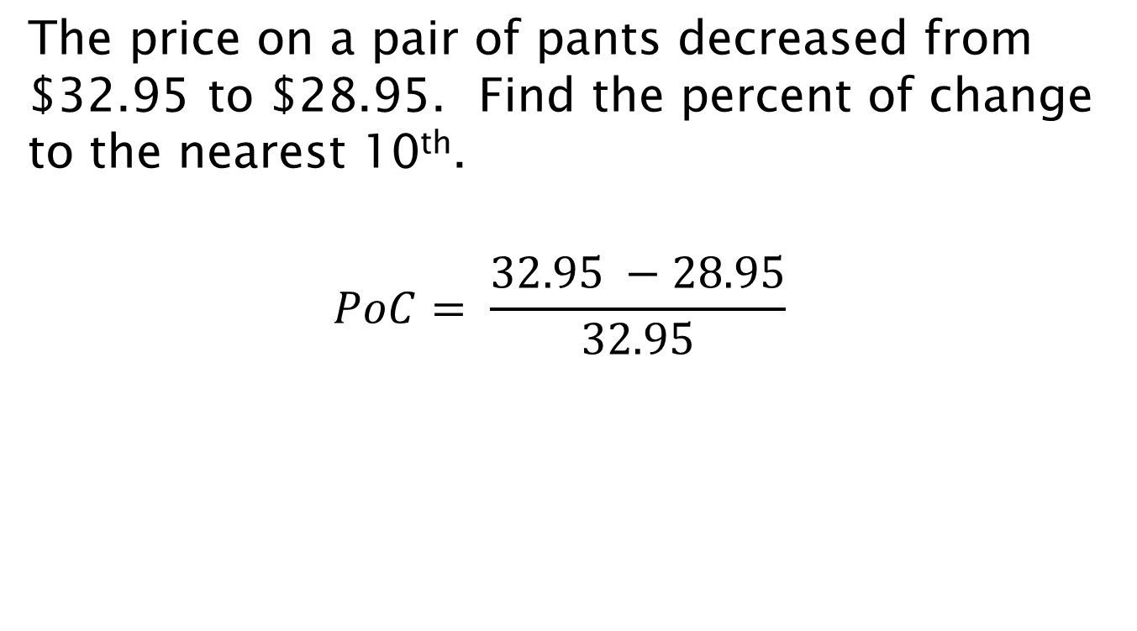
Examples
The price on a pair of pants decreased from $32.95 to $28.95. Find the percent of change to the nearest 10th.
$$PoC= \frac{32.95 −28.95}{32.95}$$

Slide 22
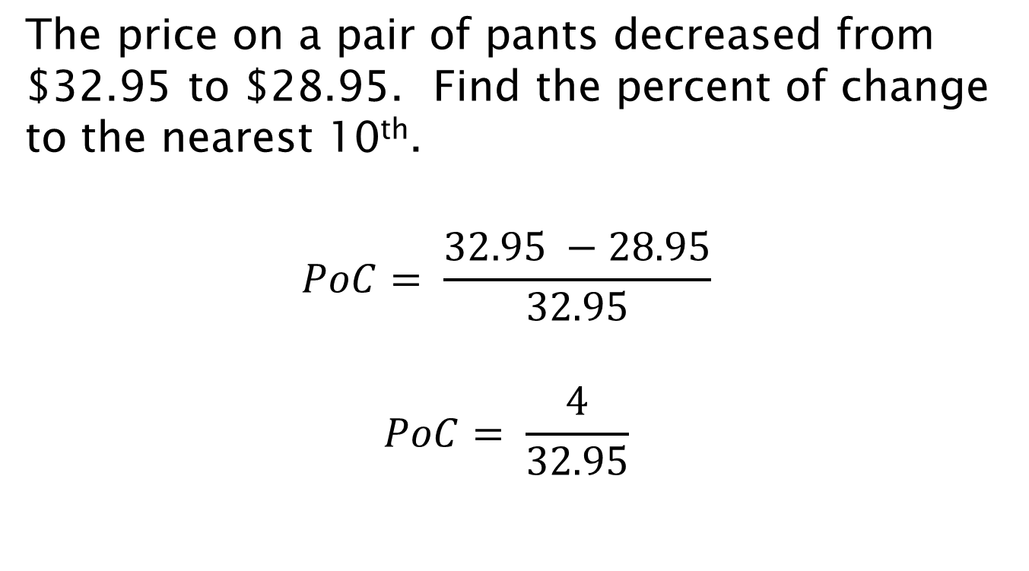
Examples
The price on a pair of pants decreased from $32.95 to $28.95. Find the percent of change to the nearest 10th.
$$PoC= \frac{32.95 −28.95}{32.95}$$
$$PoC= \frac{4}{32.95}$$

Slide 23
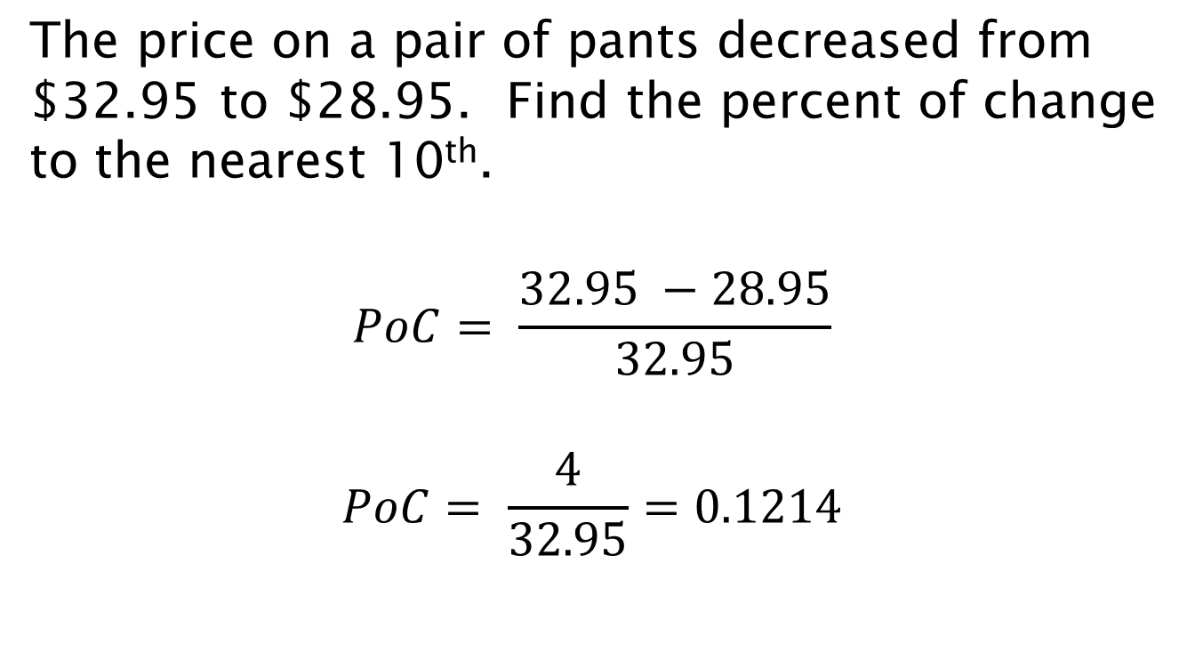
Examples
The price on a pair of pants decreased from $32.95 to $28.95. Find the percent of change to the nearest 10th.
$$PoC= \frac{32.95 −28.95}{32.95}$$
$$PoC= \frac{4}{32.95}=0.1214$$

Slide 24
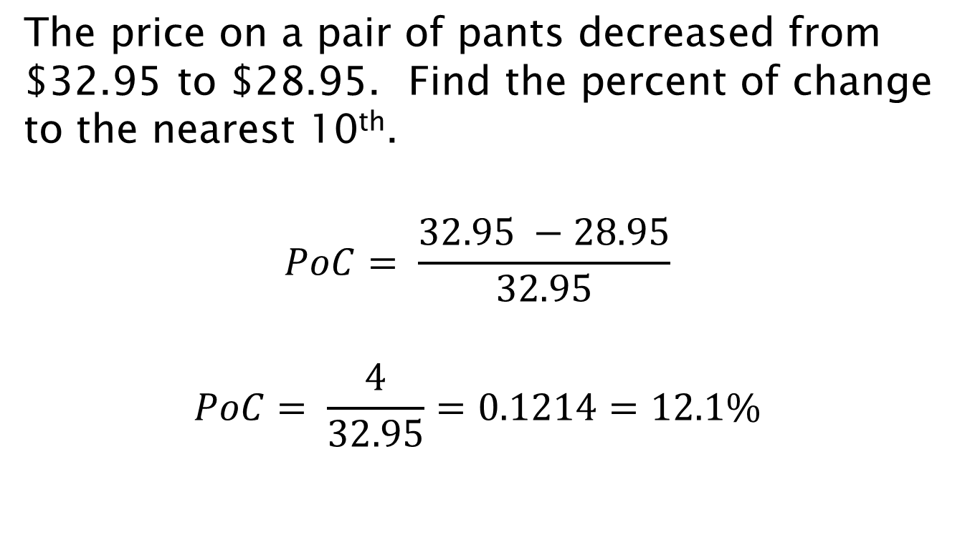
Examples
The price on a pair of pants decreased from $32.95 to $28.95. Find the percent of change to the nearest 10th.
$$PoC= \frac{32.95 −28.95}{32.95}$$
$$PoC= \frac{4}{32.95}=0.1214=12.1\%$$

Slide 25
Between 1940 and 1980, the federal budget increased from $9.5 billion to $725.3 billion. What was the percent of increase?

Slide 26
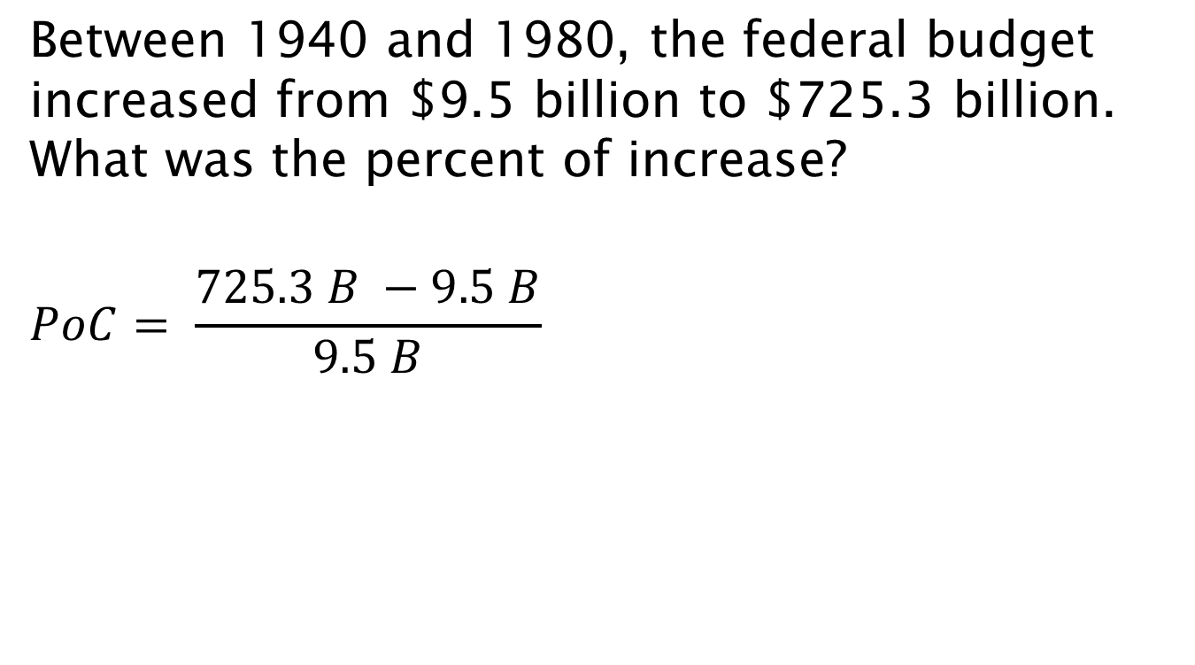
Between 1940 and 1980, the federal budget increased from $9.5 billion to $725.3 billion. What was the percent of increase?
$$PoC= \frac{725.3 B −9.5 B}{9.5 B}$$

Slide 27
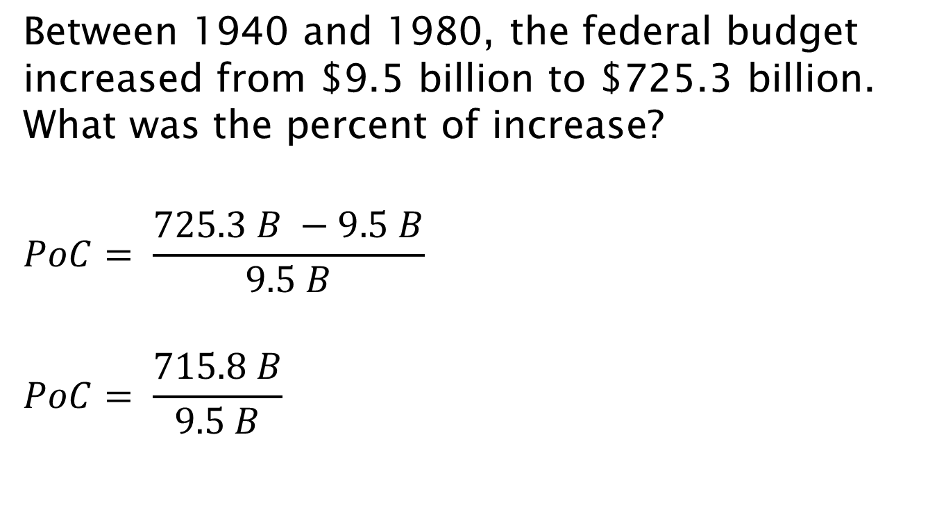
Between 1940 and 1980, the federal budget increased from $9.5 billion to $725.3 billion. What was the percent of increase?
$$PoC= \frac{725.3 B −9.5 B}{9.5 B}$$
$$PoC= \frac{715.8 B}{9.5 B}$$

Slide 28
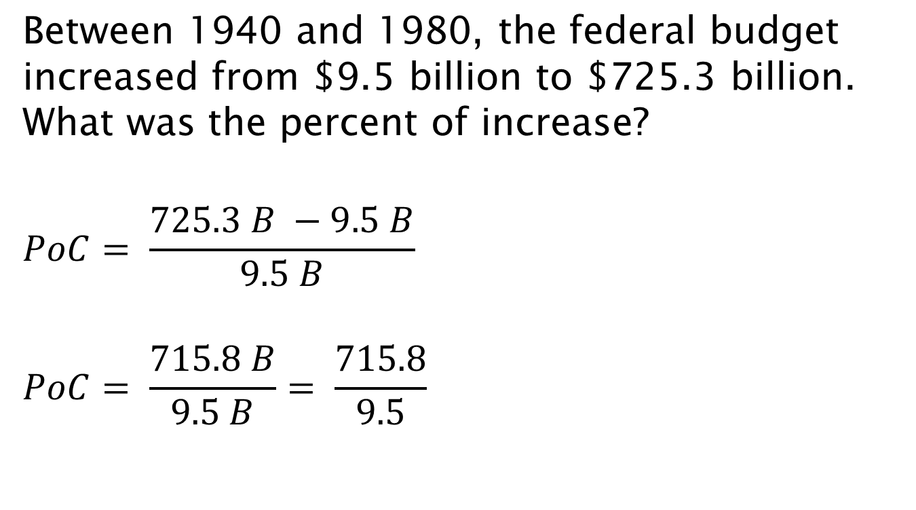
Between 1940 and 1980, the federal budget increased from $9.5 billion to $725.3 billion. What was the percent of increase?
$$PoC= \frac{725.3 B −9.5 B}{9.5 B}$$
$$PoC= \frac{715.8 B}{9.5 B}= \frac{715.8}{9.5}$$

Slide 29
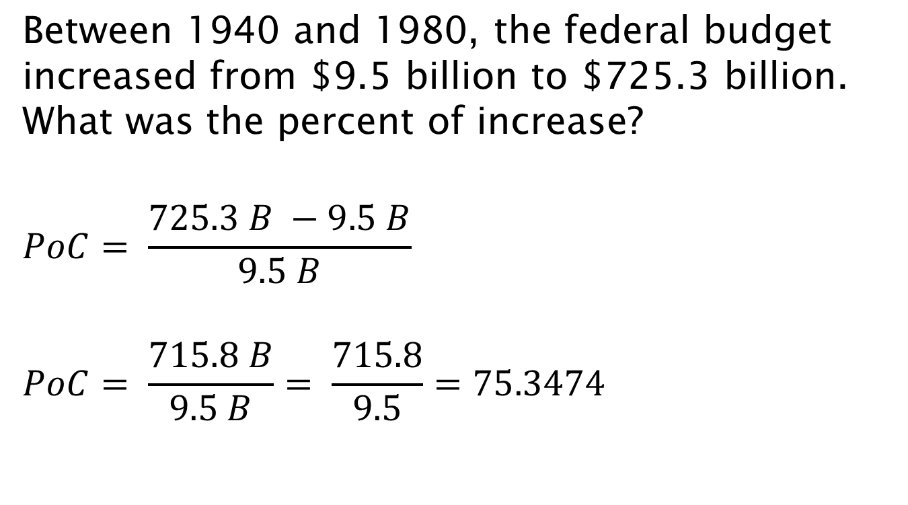
Between 1940 and 1980, the federal budget increased from $9.5 billion to $725.3 billion. What was the percent of increase?
$$PoC= \frac{725.3 B −9.5 B}{9.5 B}$$
$$PoC= \frac{715.8 B}{9.5 B}= \frac{715.8}{9.5}=75.3474$$

Slide 30
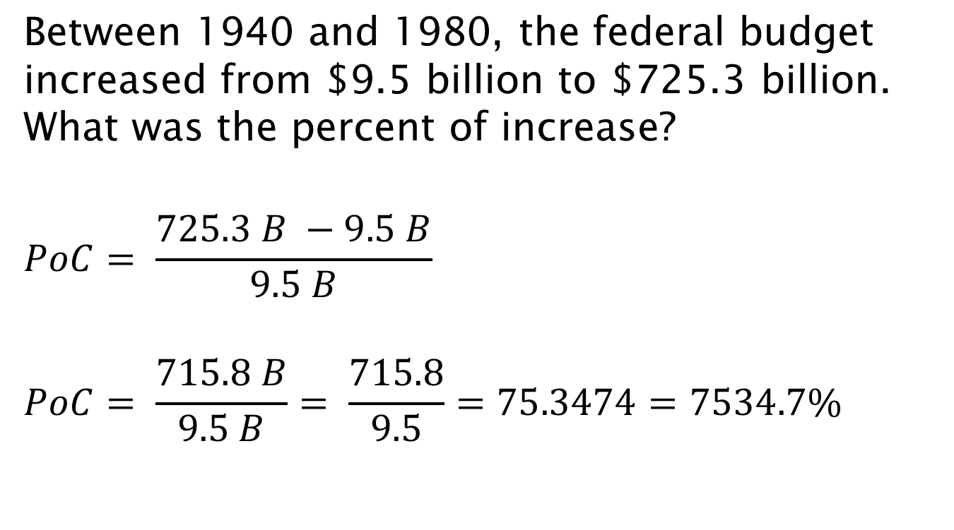
Between 1940 and 1980, the federal budget increased from $9.5 billion to $725.3 billion. What was the percent of increase?
$$PoC= \frac{725.3 B −9.5 B}{9.5 B}$$
$$PoC= \frac{715.8 B}{9.5 B}= \frac{715.8}{9.5}=75.3474=7534.7\%$$

Slide 31
In 1985, the average price for gasoline was $1.20 per gallon. In 2000, the average price was $1.56 per gallon. Find the percent of change.

Slide 32
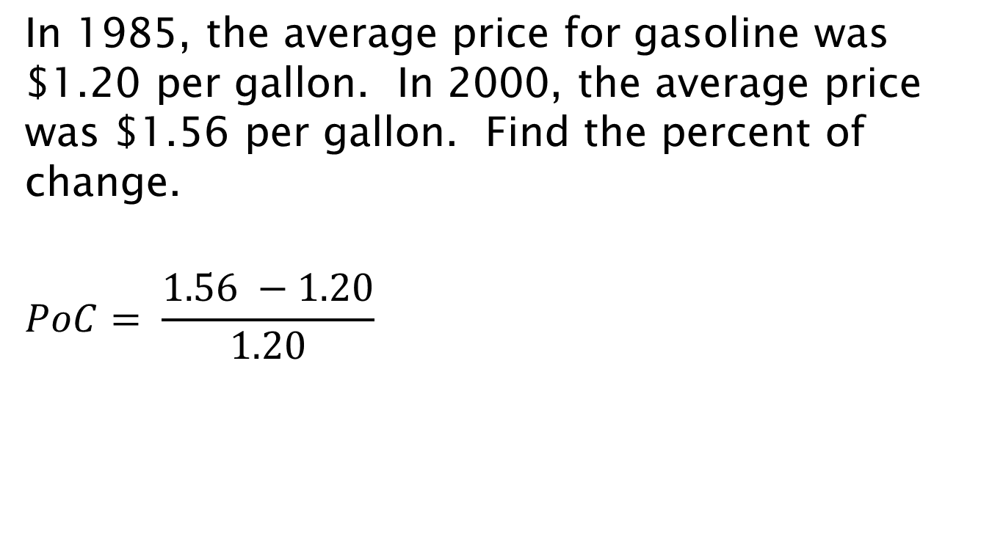
In 1985, the average price for gasoline was $1.20 per gallon. In 2000, the average price was $1.56 per gallon. Find the percent of change.
$$PoC= \frac{1.56 −1.20}{1.20}$$

Slide 33
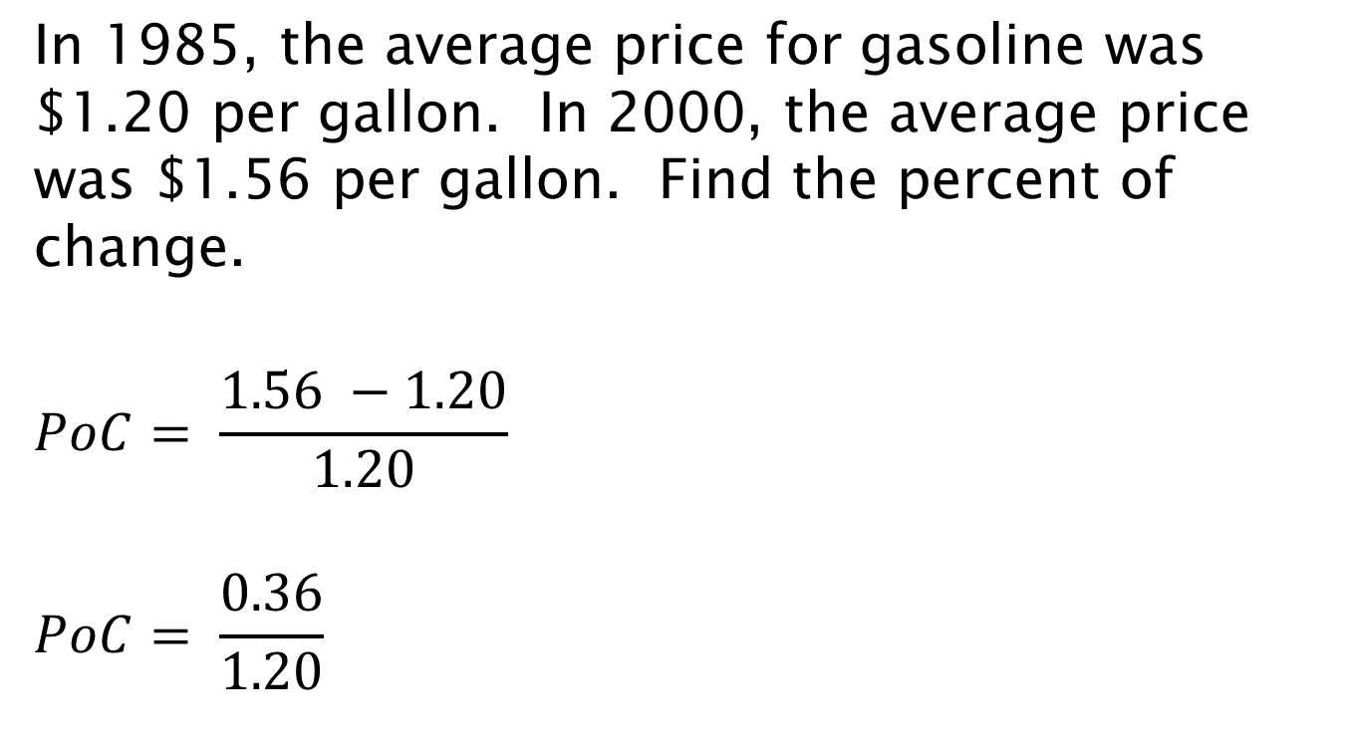
In 1985, the average price for gasoline was $1.20 per gallon. In 2000, the average price was $1.56 per gallon. Find the percent of change.
$$PoC= \frac{1.56 −1.20}{1.20}$$
$$PoC= \frac{0.36}{1.20}$$

Slide 34
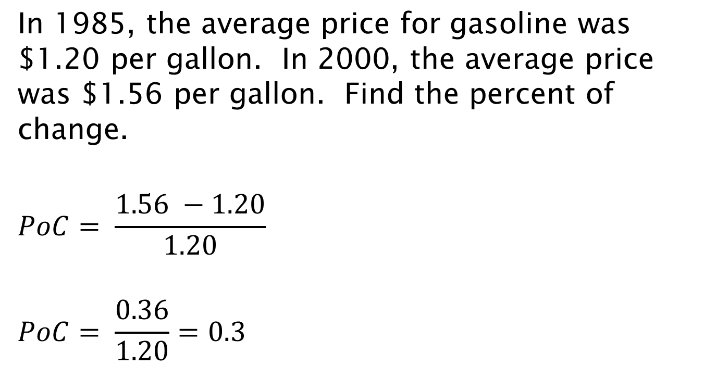
In 1985, the average price for gasoline was $1.20 per gallon. In 2000, the average price was $1.56 per gallon. Find the percent of change.
$$PoC= \frac{1.56 −1.20}{1.20}$$
$$PoC= \frac{0.36}{1.20}=0.3$$

Slide 35
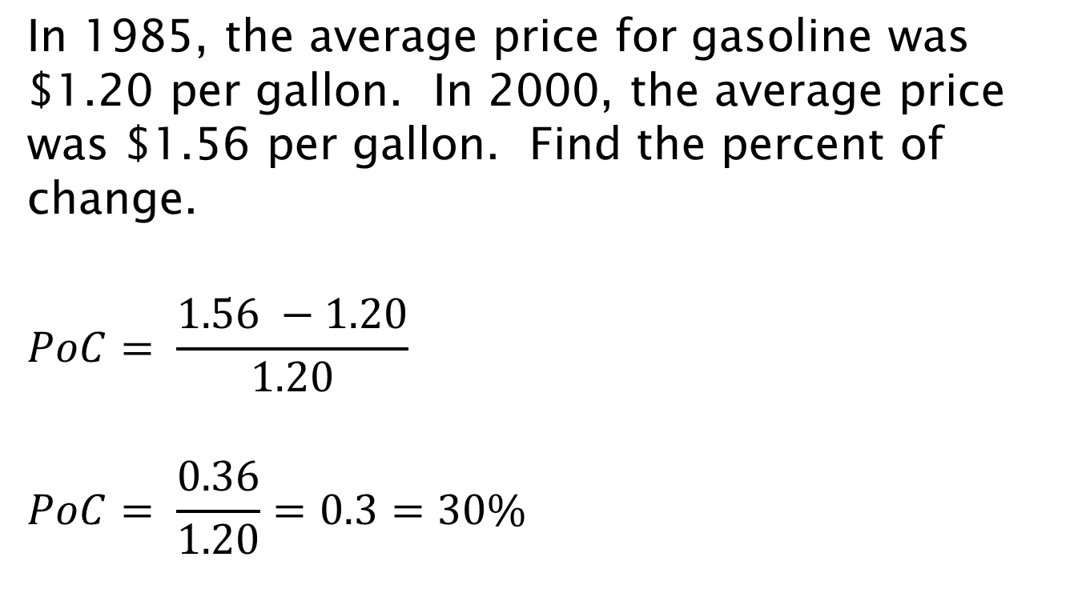
In 1985, the average price for gasoline was $1.20 per gallon. In 2000, the average price was $1.56 per gallon. Find the percent of change.
$$PoC= \frac{1.56 −1.20}{1.20}$$
$$PoC= \frac{0.36}{1.20}=0.3=30\%$$

Slide 36
During 2008, the average price for gasoline was $3.52. Find the percent of change from 1985.

Slide 37
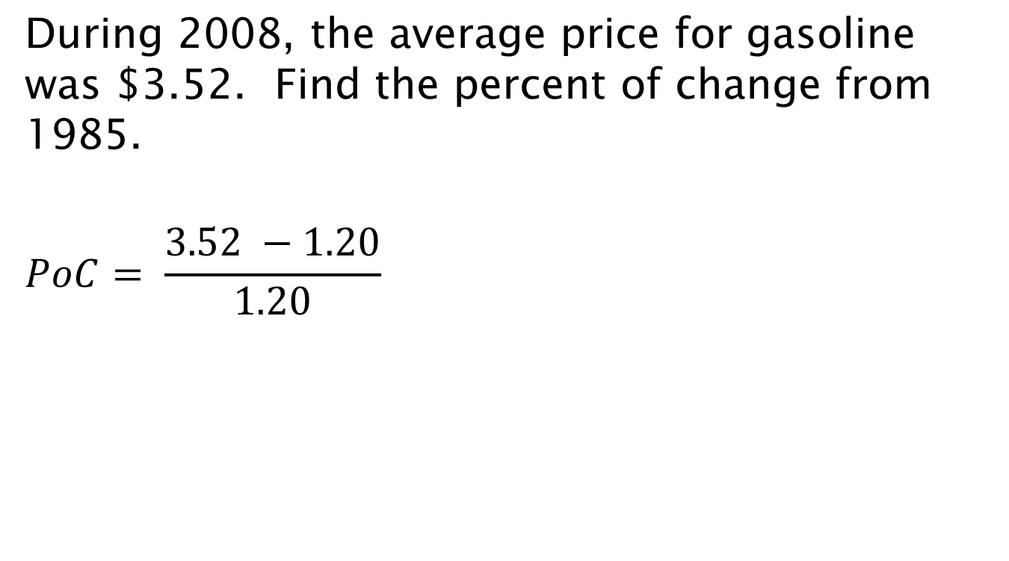
During 2008, the average price for gasoline was $3.52. Find the percent of change from 1985.
$$PoC= \frac{3.52 −1.20}{1.20}$$

Slide 38
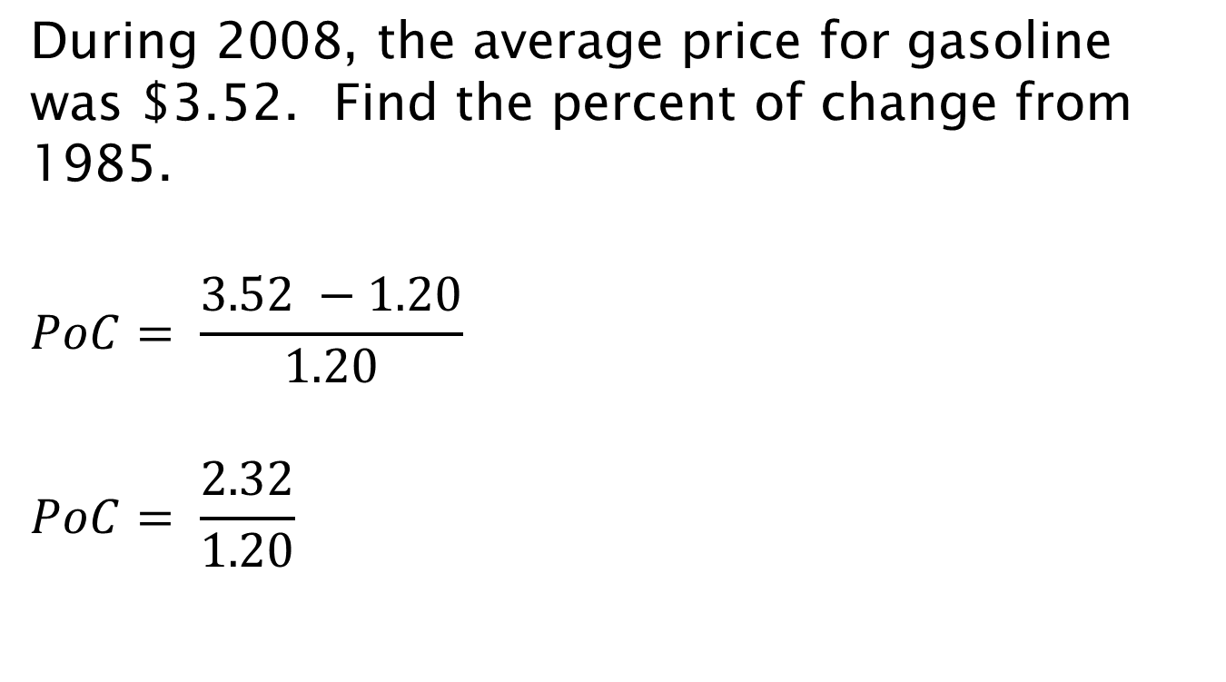
During 2008, the average price for gasoline was $3.52. Find the percent of change from 1985.
$$PoC= \frac{3.52 −1.20}{1.20}$$
$$PoC= \frac{2.32}{1.20}$$

Slide 39
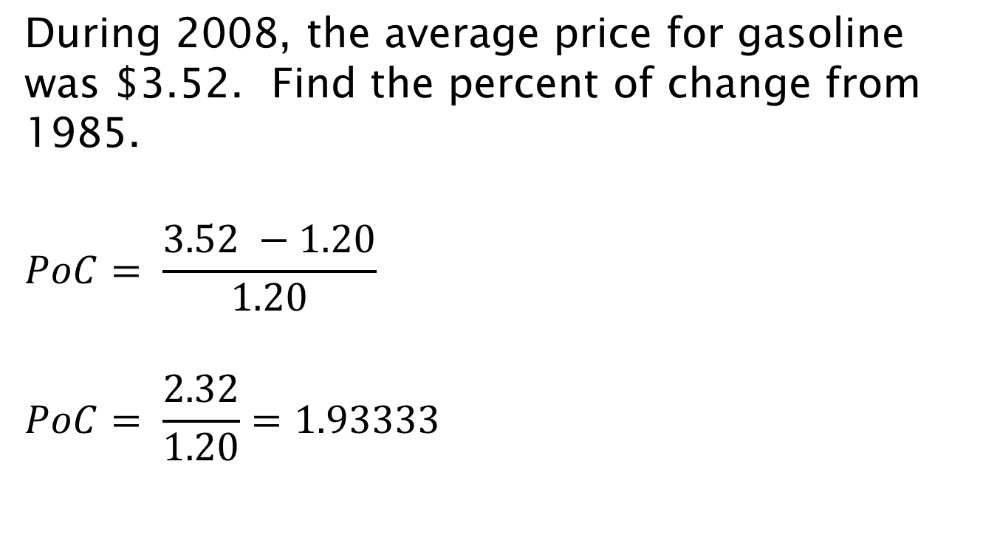
During 2008, the average price for gasoline was $3.52. Find the percent of change from 1985.
$$PoC= \frac{3.52 −1.20}{1.20}$$
$$PoC= \frac{2.32}{1.20}=1.93333$$

Slide 40
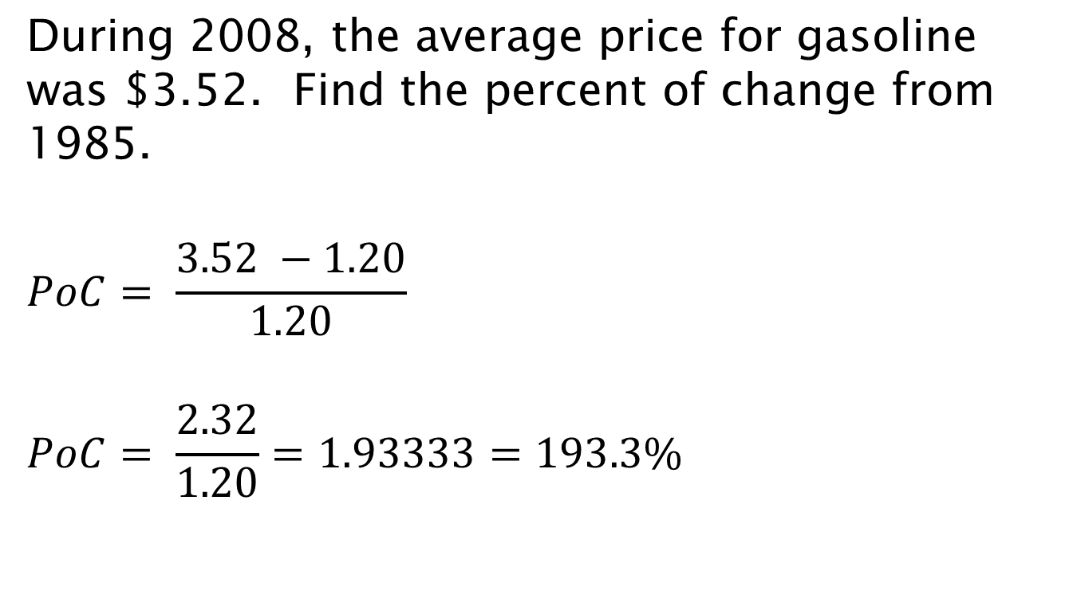
During 2008, the average price for gasoline was $3.52. Find the percent of change from 1985.
$$PoC= \frac{3.52 −1.20}{1.20}$$
$$PoC= \frac{2.32}{1.20}=1.93333=193.3\%$$

Slide 41
Greatest Possible Error (GPE)

Slide 42
Greatest Possible Error (GPE)
One half of the measuring unit

Slide 43
Greatest Possible Error (GPE)
One half of the measuring unit
Examples:
4 lbs → ½ lb or 0.5 lb
4 in → ½ in or 0.5 in
6.7 km → 0.05 km

Slide 44
Example
Find the greatest possible error in a 25-ft measurement.

Slide 45

Example
Find the greatest possible error in a 25-ft measurement.
$$GPE=0.5 ft$$

Slide 46
Percent Error

Slide 47

Percent Error
$$Percent Error= \frac{GPE}{Measurement}$$

Slide 48
Example
Find the percent error in the measurement.
168 inches

Slide 49

Example
Find the percent error in the measurement.
168 inches
$$Percent Error= \frac{0.5}{168}$$

Slide 50
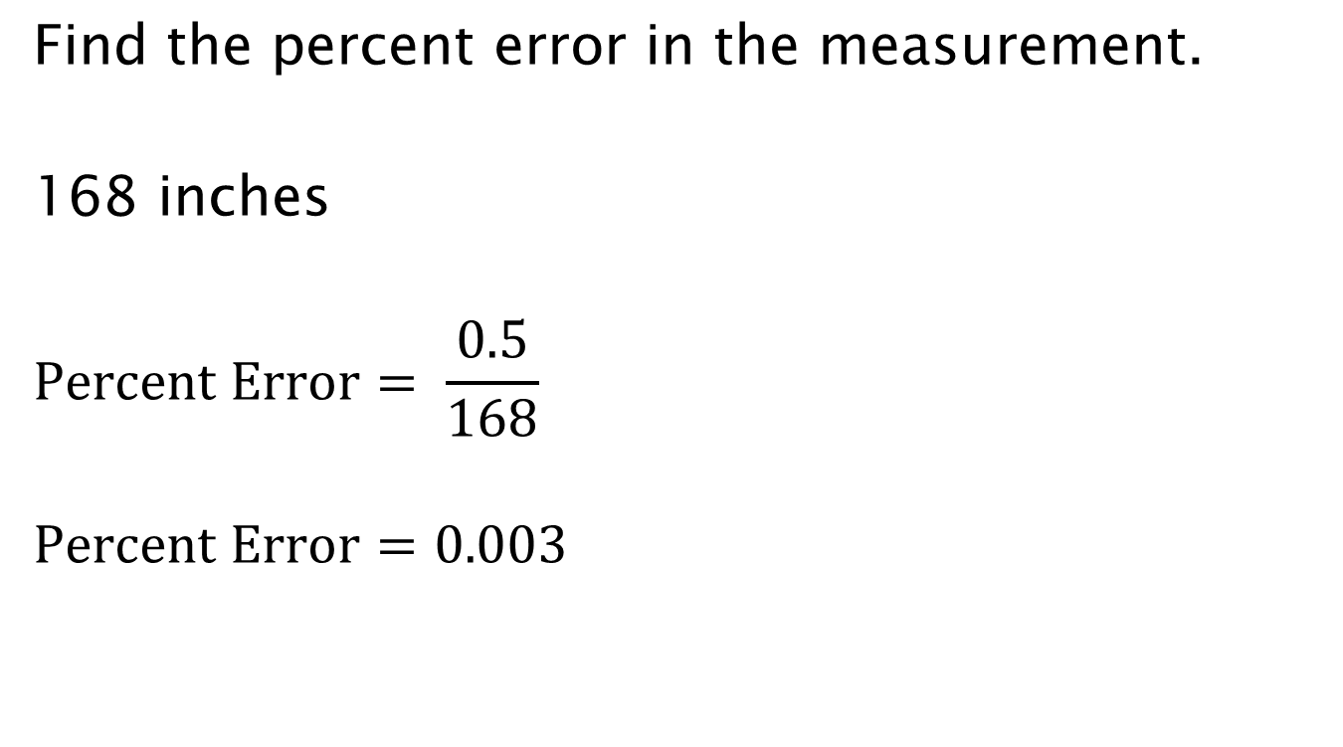
Example
Find the percent error in the measurement.
168 inches
$$Percent Error= \frac{0.5}{168}$$
$$Percent Error=0.003$$

Slide 51
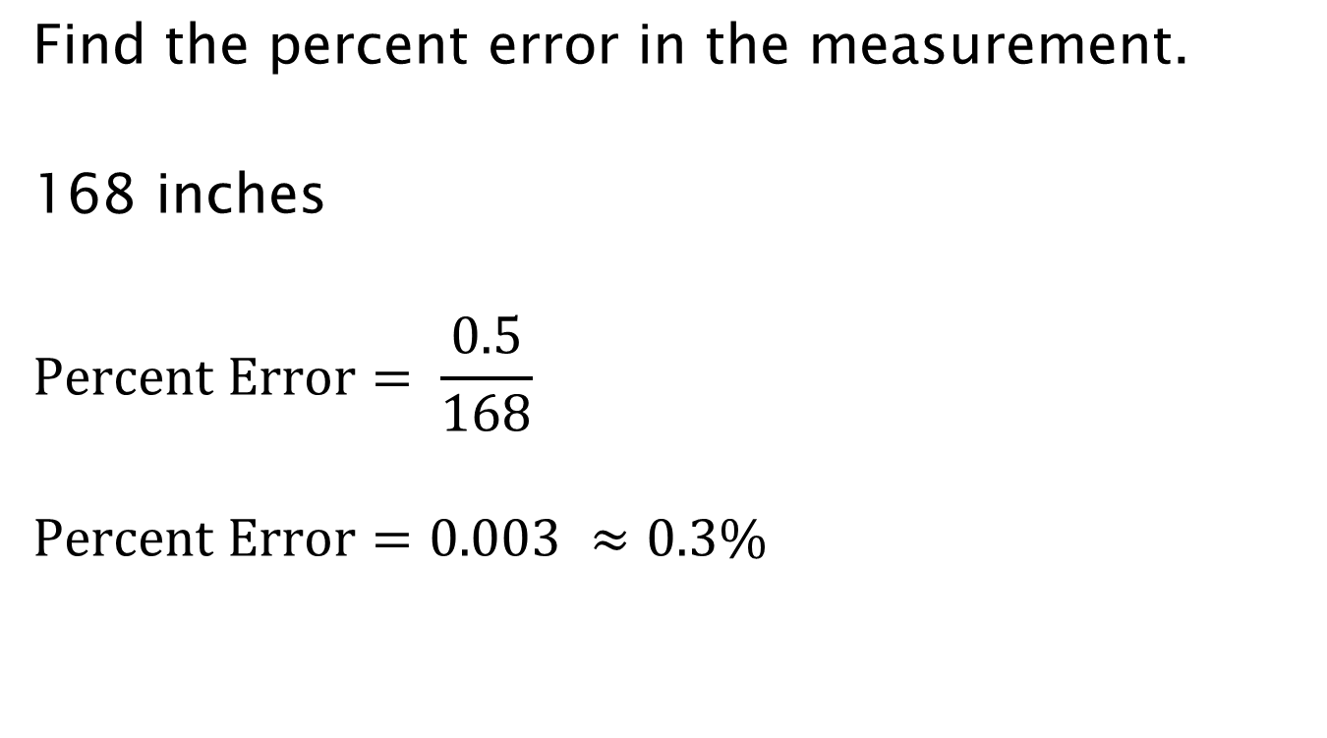
Example
Find the percent error in the measurement.
168 inches
$$Percent Error= \frac{0.5}{168}$$
$$Percent Error=0.003 ≈0.3\%$$

Slide 52
Example
Find the percent error in the measurement.
5 feet

Slide 53

Example
Find the percent error in the measurement.
5 feet
$$Percent Error= \frac{0.5}{5}$$

Slide 54

Example
Find the percent error in the measurement.
5 feet
$$Percent Error= \frac{0.5}{5}$$
$$Percent Error=0.1$$

Slide 55

Example
Find the percent error in the measurement.
5 feet
$$Percent Error= \frac{0.5}{5}$$
$$Percent Error=0.1=10\%$$

Slide 56
Assignment
4.4: 1 – 18, 25 – 28, 30 - 40

